Slide 1
IBM University Engagement Project Submission
“Exploring the Power of Agentic AI with IBM Cloud and Orchestrate”

Slide 2

Project Tile – [Smart Satellite Communication Knowledge Assistant ]
Domain of Project – [Electronics and Telecommunications Engineering ]
Student Name | Recent Passport Photo | Email ID | Mobile number [WhatsApp]
BHUMIKA JITENDRASINGH CHOUDHARY |  | bhumikajchoudhary07@gmail.com | 8408883715

Slide 3
Problem Statement : Smart Satellite Communication Knowledge Assistant
The Challenge:
Satellite communication systems involve complex concepts such as frequency bands, signal modulation, link budgets, and communication protocols. Engineers and students often struggle to understand these topics because the knowledge is distributed across textbooks, research papers, and technical documentation. Finding relevant information and troubleshooting communication issues can take significant time.
The Objective:
Build a Satellite Communication Knowledge Assistant that helps users understand and troubleshoot satellite communication systems. The solution should:
Knowledge Retrieval :- Extract information from satellite communication documents and technical materials.
Concept Explanation :- Explain complex topics such as modulation techniques, frequency bands, and link budgets in simple language.
Troubleshooting Support :- Provide guidance for solving satellite communication problems.
Conversational Interface :- Allow users to ask questions and receive responses through an interactive chat interface.

Slide 4
Proposed Solution : Smart Satellite Communication Knowledge Assistant
The proposed solution is an AI-powered SatCom (Satellite Communication ) Assistant built using GitHub, and IBM watsonx.ai to provide personalized, real-time assistance. The system addresses challenges in understanding the complex satellite communication systems. It is named Orbitron.
The Smart Satellite Communication Knowledge Assistant is an AI-powered virtual assistant designed to provide accurate, interactive, and easy-to-understand information about satellite communication. It serves as a centralized knowledge platform where users can ask questions in natural language and receive instant, context-aware responses on topics such as satellite systems, orbital mechanics, frequency bands, communication protocols, applications, and emerging technologies.
The assistant leverages advanced natural language processing (NLP) and retrieval-based AI to simplify complex technical concepts, making them accessible to students, educators, researchers, and professionals alike. In addition to answering queries, it can explain concepts, recommend study materials, clarify technical terminology, and assist with exam preparation or project work. By offering 24/7 access to reliable information through a conversational interface, the solution enhances learning, improves knowledge accessibility, and reduces the time required to search through multiple technical resources.

Slide 5
Technology Used
IBM Granite model – ibm-granite-3-2-8b – For natural language understanding, reasoning, and personalization
IBM Cloud – It provides the infrastructure to build, deploy, and scale the SatCom Assistant efficiently. IBM Cloud enables a reliable, secure, and scalable environment for deploying the SatCom Assistant.
RAG – RAG to fetch real data first, then generate intelligent answers, making the SatCom Assistant more trustworthy and effective.
IBM Watsonx.ai - For model deployment, embeddings, and AI governance.

Slide 6
Orchestrate component Used -
1) Chat Input – Interface where users enter their queries, research paper, or problems (text/doc/image).
2) IBM watsonx AI Agent - Processes user input using Granite models to generate personalized satellite communication insights and recommendations.
3) Name of IBM Granite model - Granite-4.0-8B-Instruct → Fast, efficient for real-time diet recommendations
4) Chat output - Displays AI-generated responses such as definitions, explanations, and summaries.
5) File components – Stores and retrieves the textbook syllabus, research paper, MATLAB guide book for accurate explanations and summarizations.

Slide 7
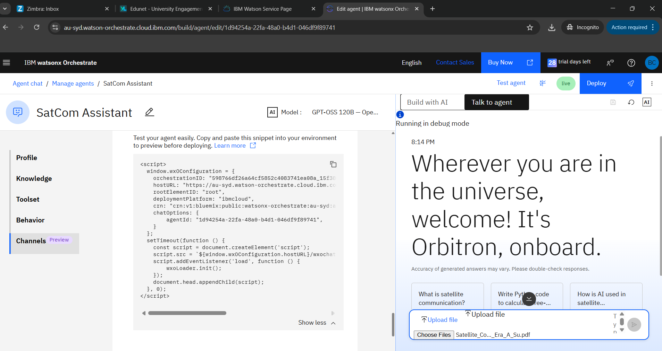
Agent Instructions Screenshot:

Slide 8
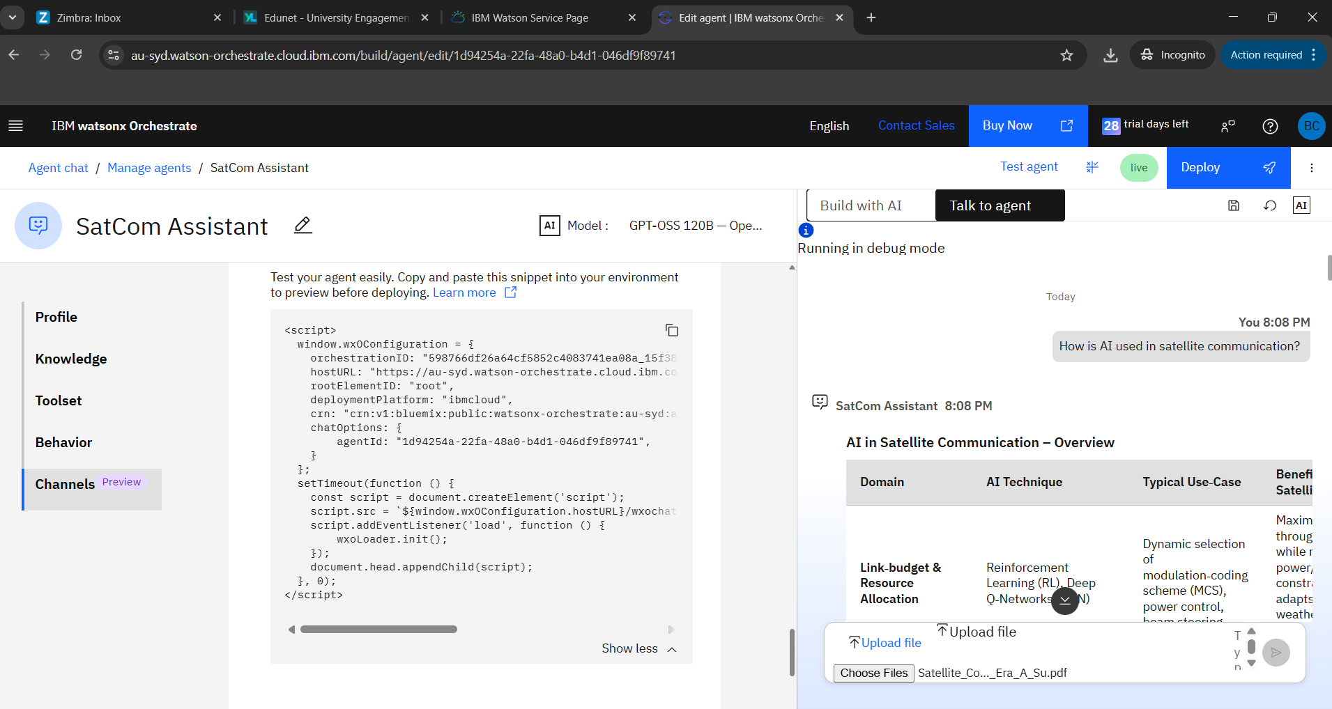
Prompt with output Screenshot:

Slide 9
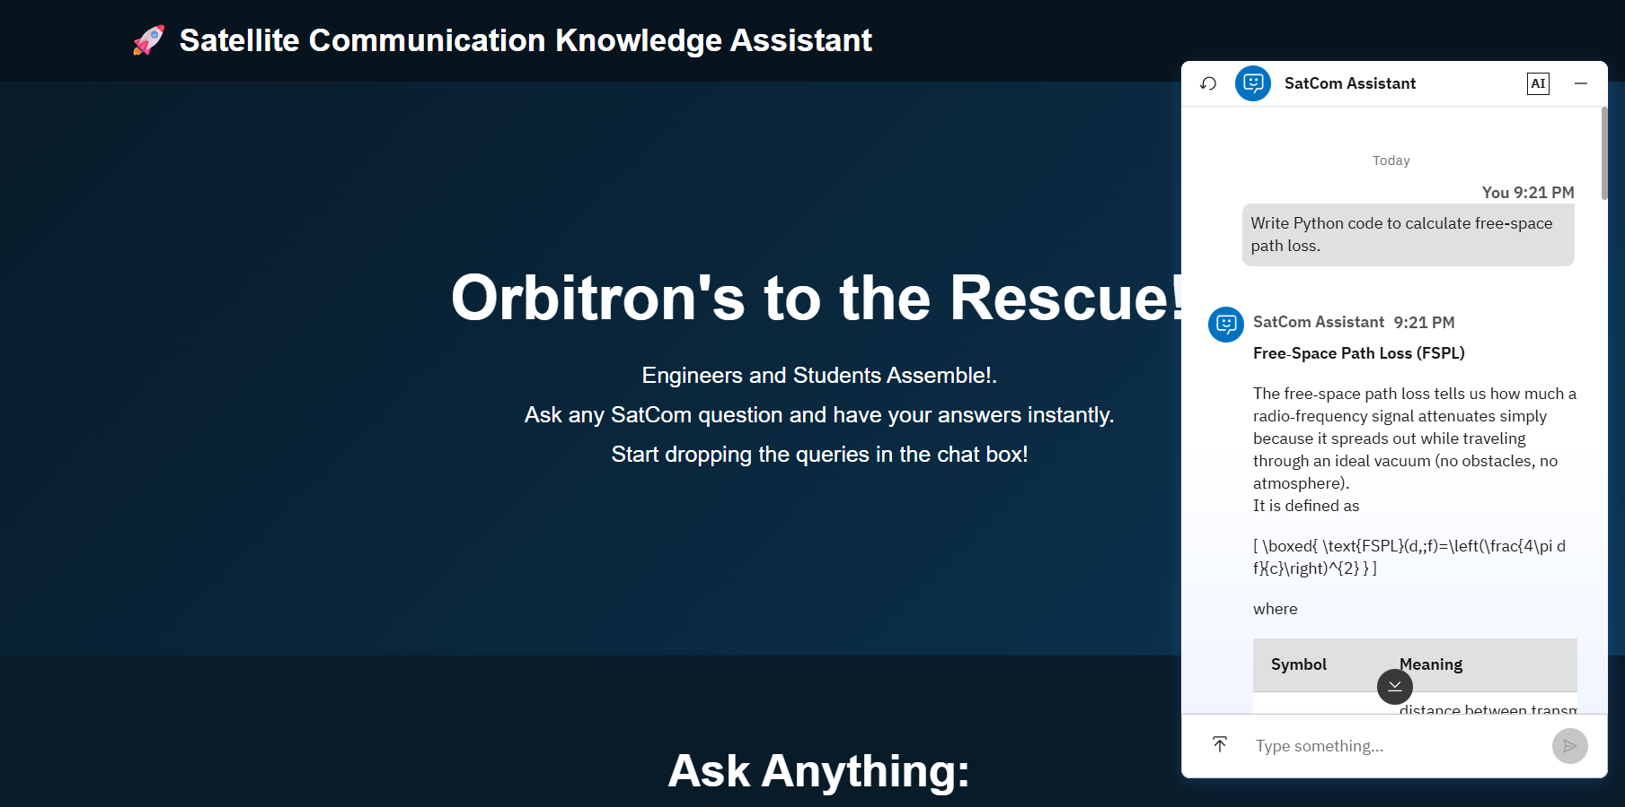
Prompt with output Screenshot:

Slide 10
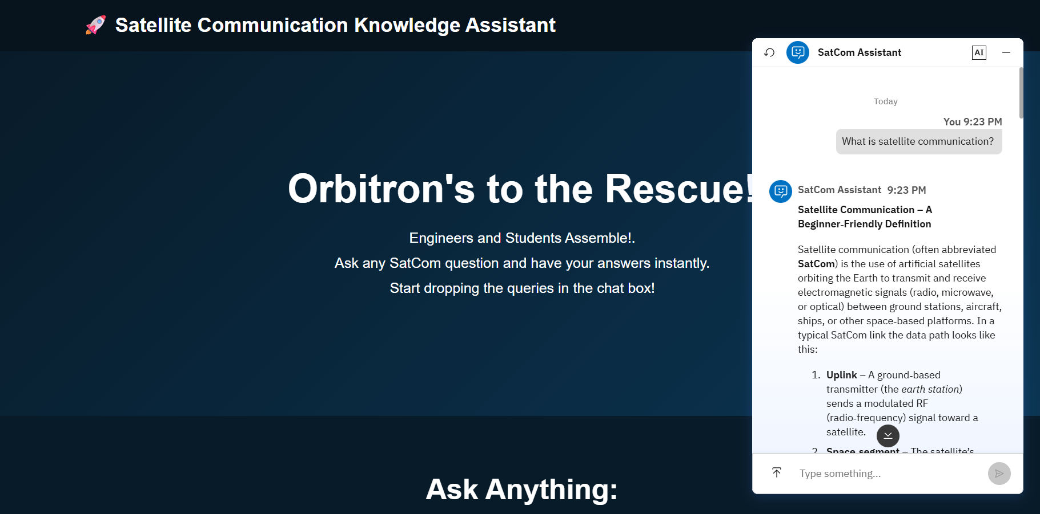
Prompt with output Screenshot:

Slide 11

Role of Agentic AI in the solution:
Role of Agentic AI in SatCom Assistance
Agentic AI enables the SatCom Assistant to function as an intelligent, autonomous system rather than a simple chatbot. Using IBM watsonx.ai and IBM Granite models, it coordinates multiple specialized agents to deliver personalized knowledge assistance.
It retrieves satellite communication data, generates study plans, provides necessary information, and gives summaries using the textbooks and research papers. This multi-agent approach ensures efficient knowledge gain and accurate information.
Overall, Agentic AI makes the system proactive, personalized, and goal-driven, acting like a smart digital assistant that helps users understand complex concepts easily.

Slide 12
Novelty and Uniqueness:
The proposed SatCom Agent stands out by combining Agentic AI, RAG, and personalization into a single intelligent system.
Multi-Agent Intelligence – Instead of a single chatbot, multiple specialized agents collaborate to deliver accurate and context-aware knowledge assistance.
RAG-Based Accuracy – Integrates real-time data retrieval with AI generation, reducing misinformation and ensuring accurate information.
Hyper-Personalization – Tailors study plans based on syllabus, research papers, and textbooks.
Real-Time Feedback Loop – Continuously adapts recommendations based on daily query logs and user behavior.
Multi-Modal Input – Supports text, doc, and image-based information tracking for better usability.
Scalable & Enterprise-Ready – Built on IBM watsonx.ai with IBM Granite models, ensuring reliability and governance.
This makes the solution a smart, adaptive, and proactive digital assistant, not just a static study recommendation tool.

Slide 13
GitHub Link:
https://github.com/lhsisequaltorhs/Smart-Satellite-Communication-Knowledge-Assistant
·
·
·

Slide 14
Future Scope:
The Smart Satellite Communication Knowledge Assistant has significant potential for future enhancements, allowing it to evolve into a comprehensive learning and professional support platform. Possible future developments include:
Personalized Learning: Recommend study plans, quizzes, and learning resources based on the user's knowledge level and progress.
Interactive Simulations: Incorporate visual demonstrations of satellite orbits, signal propagation, link budgets, and communication systems to improve conceptual understanding.
Integration with Real-Time Satellite Data: Connect to live satellite tracking services and space weather data to provide current information about satellites, launches, and orbital events.
Academic Assistance: Expand support for solving numerical problems, generating practice questions, explaining mathematical derivations, and assisting with assignments related to satellite communication.
Industry Applications: Provide troubleshooting guidance, standards documentation, and technical references for engineers and professionals working in satellite communications.
IoT and 5G/6G Integration: Include knowledge related to satellite-enabled IoT networks, non-terrestrial networks (NTN), and future 6G satellite communication technologies.
·
·
·

Slide 15
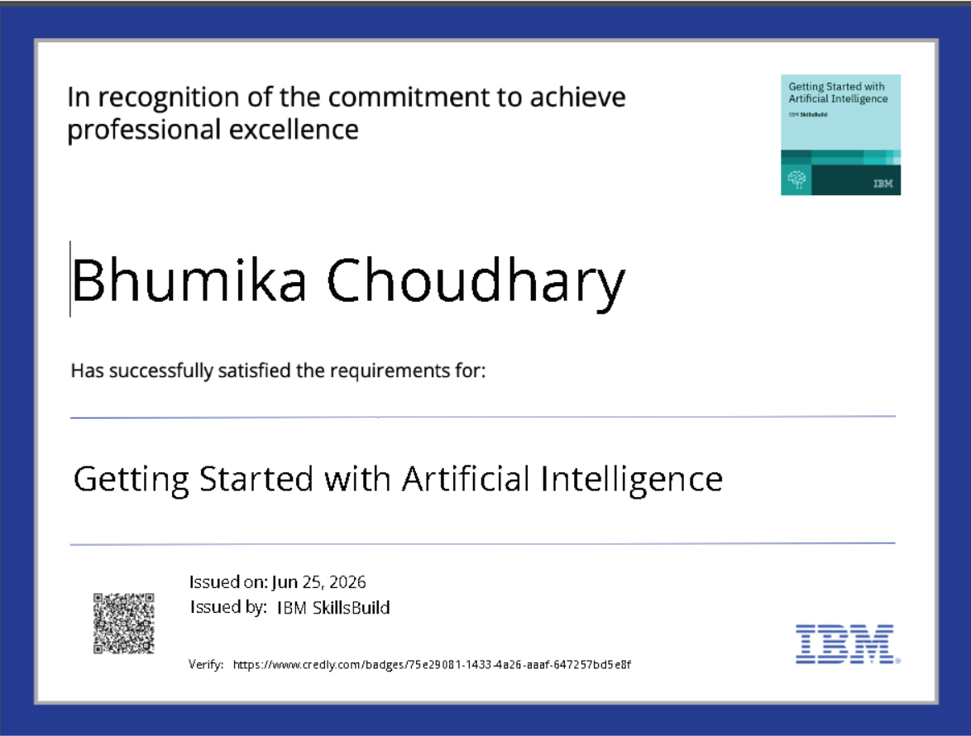
Certificates Earned:

Slide 16
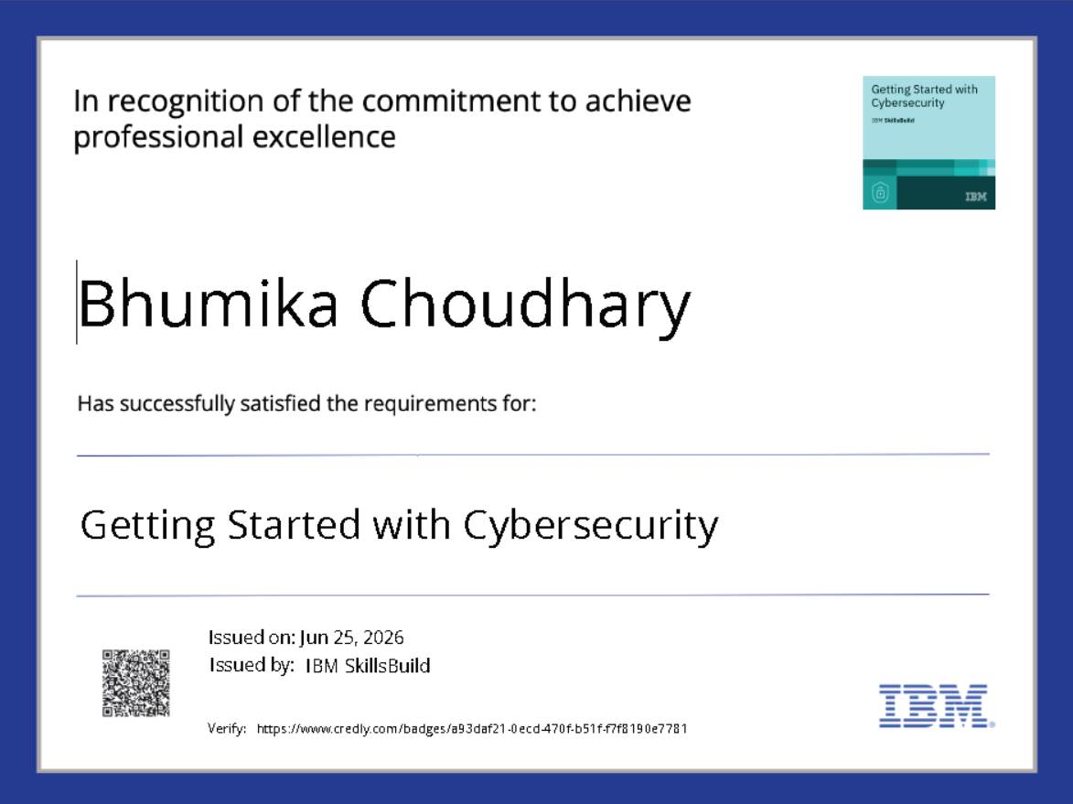
Certificates Earned:

Slide 17
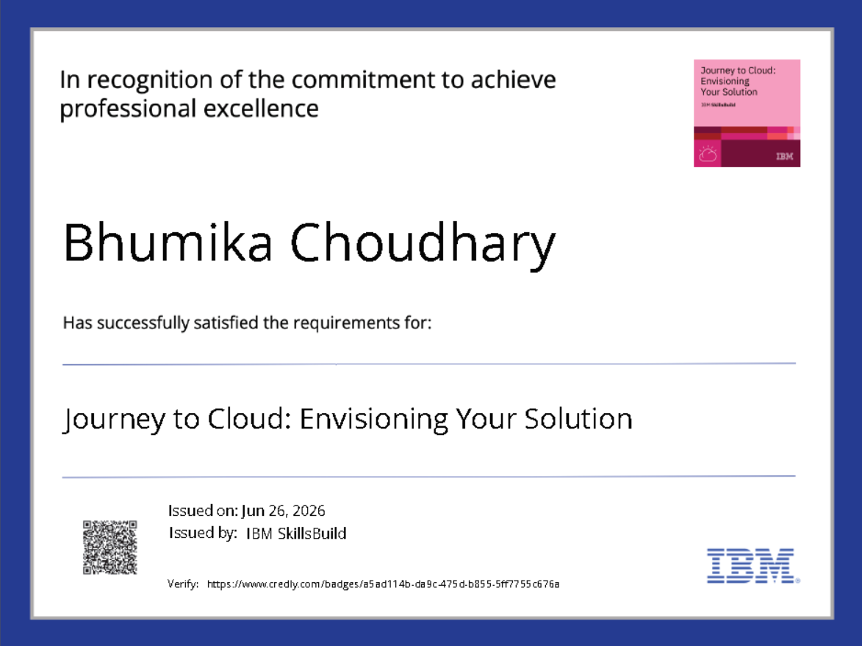
Certificates Earned:

Slide 18
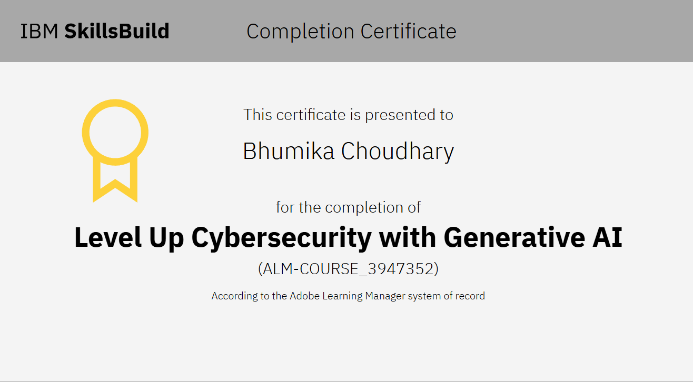
Certificates Earned:

Slide 19
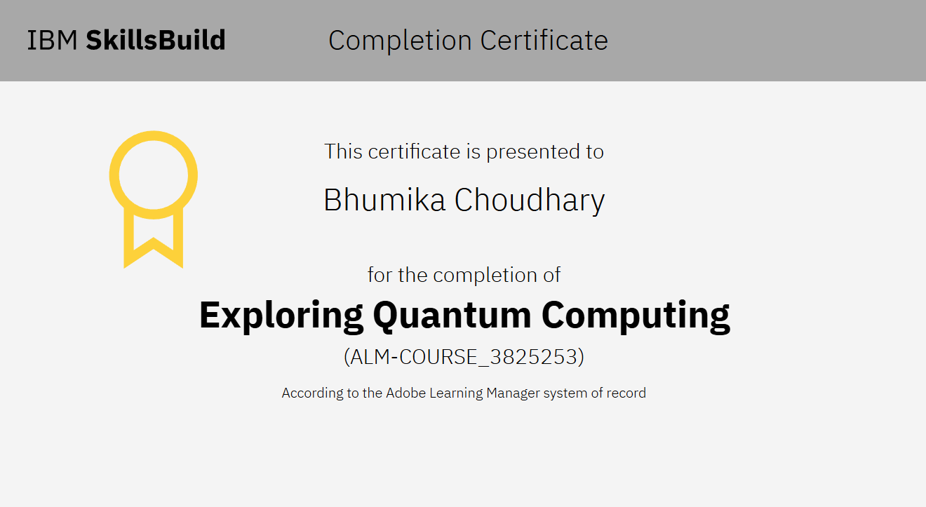
Certificates Earned:

Slide 20
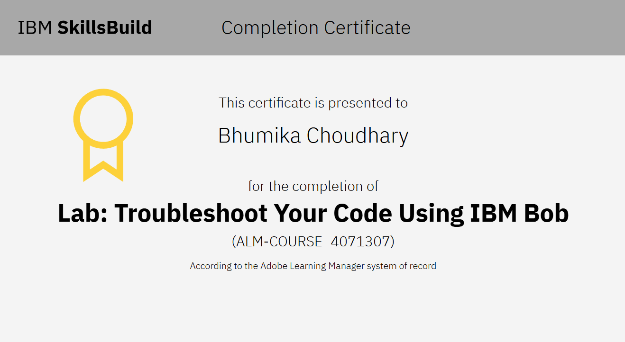
Certificates Earned:

Slide 21


